Slide 1
The Detection of Fertility Hormones via Antibody
Immobilization and Electrochemical Impedance Spectroscopy
Student: Stephanie Maxwell
Mentor: Dr. Jeffrey La Belle

Slide 2
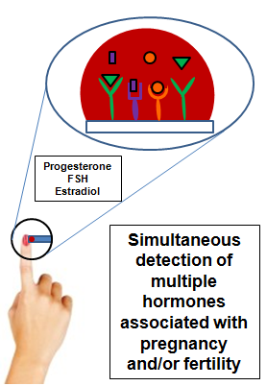
The Objective:

Slide 3
WHY?
More than 500,000 pregnancies each year end in miscarriage (occurring during the first 20 weeks).
Over six million women in the United States struggle with becoming or staying pregnant.
Hormone levels are constantly changing, and at times drastically.
Pregnancies among women aged >40 years are associated with more non-severe complications, more premature births, more congenital malformations and more interventions at birth.

Slide 4
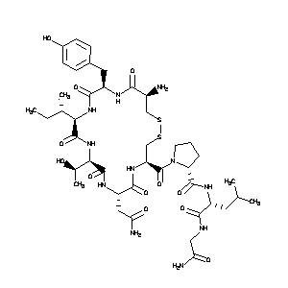
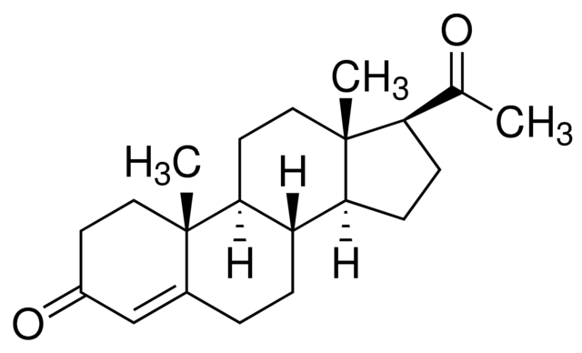
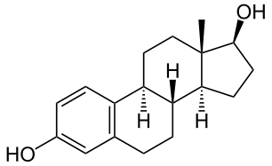
Target Hormones
Progesterone Molecule: Progesterone is a steroid hormone, and it plays an important role in the preparation for and maintenance of pregnancies
Estradiol Molecule: Estradiol is a hormone associated with triggering responses that initiate ovulation
Follicle Stimulating Molecule: The amount of FSH varies throughout a woman's menstrual cycle and is highest just before she releases an egg

Slide 5
Methods:
Immobilization

Slide 6
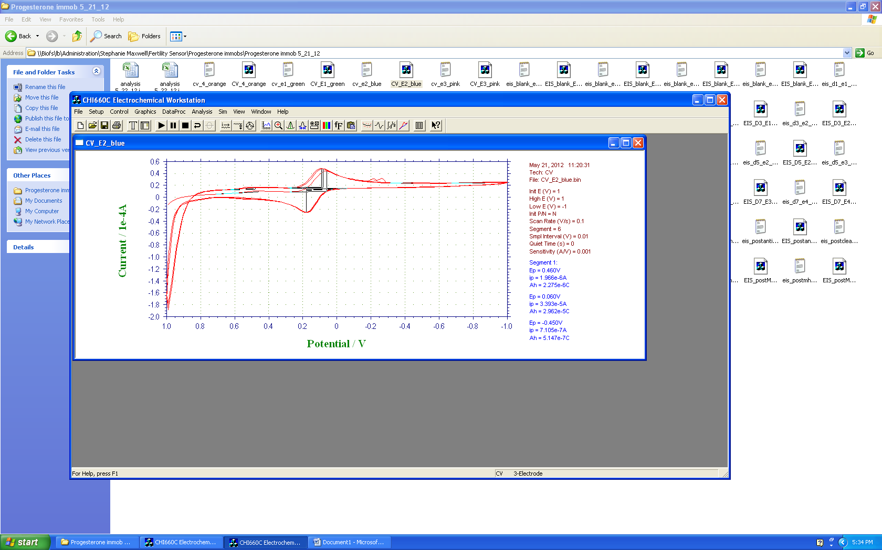
Methods: Cyclic Voltammetry
INPUT
OUTPUT
Notes:
Find the formal potential (DC offset) of the electrode by calculating the midpoint voltage between the oxidation and reduction peaks in a CV of the solution without target. It is circled in blue. If immobilization is required, that process will be completed next.

Slide 7
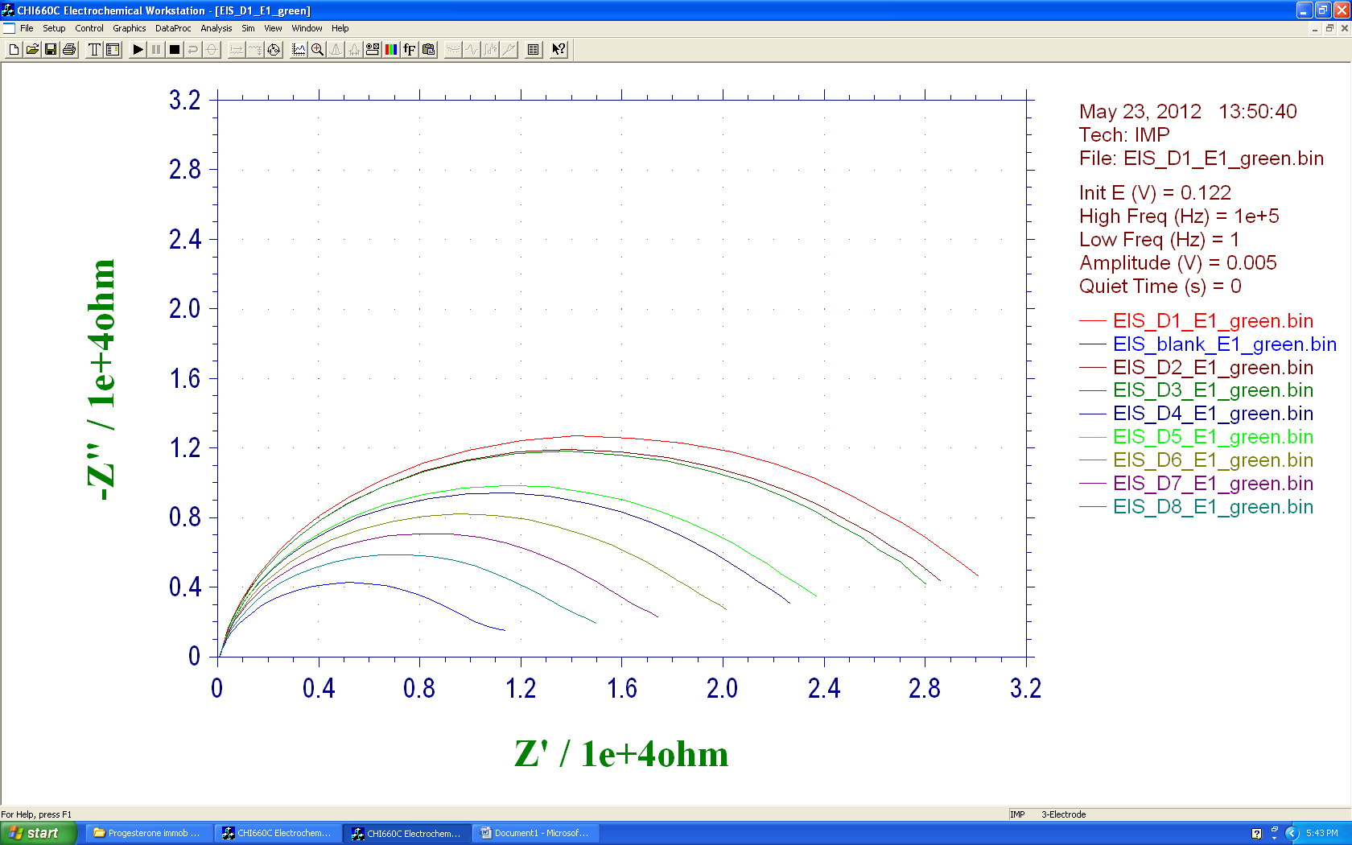
Methods:
Electrochemical Impedance Spectroscopy
Notes:
In EIS, a range of frequencies is applied to the solution and the response in terms of impendence and phase change is recorded. The data from the impedance and phase change is combined to calculate a nyquist plot which in our case, is used to determine optimal binding frequency; the frequency at which the highest amount of target has bound to the surface, antibody, or enzyme. Once the optimal binding frequency is determined by analyzing a concentration gradient’s slope and R^2 values, a plot for the calibration curve for that target at its optimal binding frequency is created. This process is explained pictorially below:

Slide 8
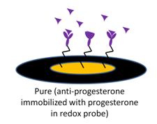
Calibration Curve
Calibration curve created from the average of 7 different concentration gradients performed through EIS. Impedances were taken at the specific binding frequency (371Hz).

Slide 9
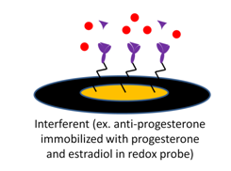
Interferent Testing
Calibration curves created after adding a concentration gradient of interferents to a concentration gradient of progesterone.

Slide 10
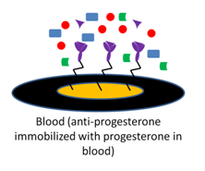
Calibration in blood
The effect of blood percentage on the slopes and R squared values of calibration curves of progesterone at 371Hz

Slide 11
Conclusions
The optimal binding frequency of progesterone was found (371Hz) and a linear relationship between impedance and log concentration was determined
This relation is reproducible (R^2=0.99, n=7)
The response decreases with an increase in blood percentage
The relation holds true with Estradiol acting as an interferent; however a lot of noise is produced with the addition of Albumin

Slide 12
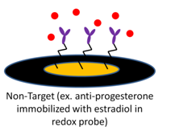
Next steps
Non-target testing will also be completed to further prove specificity of the antibody
Selectivity
Sensitivity
Combining and analyzing data from all targets

Slide 13
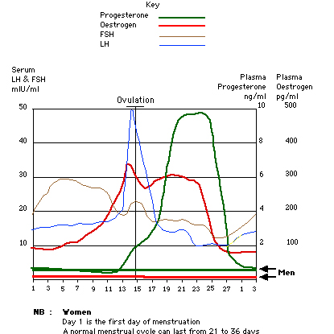

Final Goal
ν₁
Electrochemical Impedance Spectroscopy
ν₂
Impedance (Z)
ν₃
Target Concentration
Progesterone
FSH
Estradiol
Simultaneous detection of multiple hormones associated with pregnancy and/or fertility
http://www.progesteronetherapy.com/image-files/graph.jpg

Slide 14
Thank you!

